Slide 1
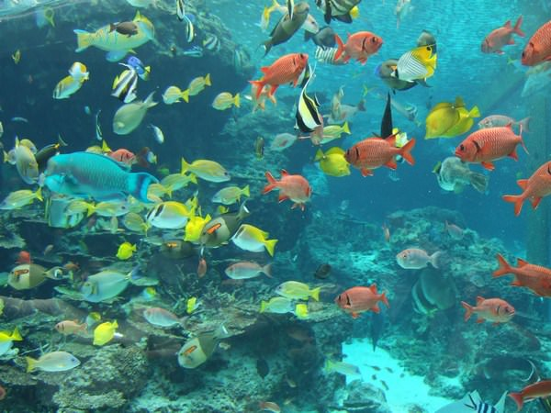

FishingPlace

Slide 2

Problem analysis

Slide 3
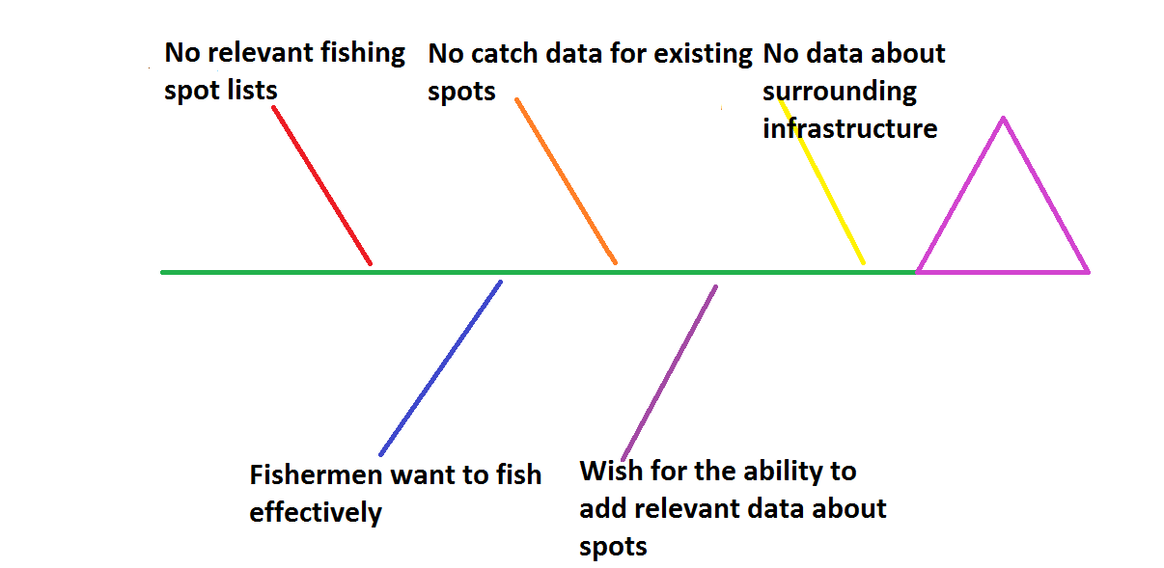
Fishbone Diagram

Slide 4
Pareto diagram

Slide 5
Слайды Оли

Slide 6


3.System definition
Specification of requirements for subsystems
Vision Document
MRD
Document Delta Vision

Slide 7
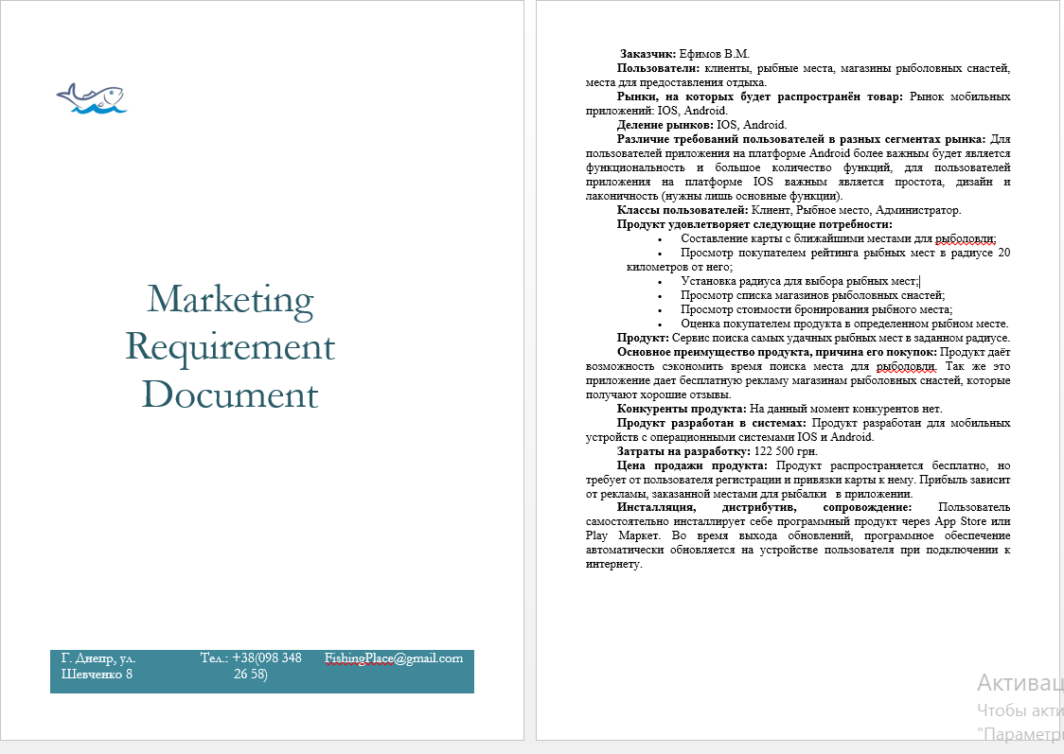
Marketing Requirements Document
It is a document created in order to simplify communication between leadership, service marketing and developer and help in making reasonable business decisions.

Slide 8


Vision Document
The purpose of creating this mobile application is the need for qualitative products and the solution of the problem of minimizing the time of searching for quality fishing places. The version of the software product at the time of writing the concept document is 1.0.1.
Main users of the system: • Stores products with good reputation and product quality. • A variety of plate-based buyers with a mobile device.

Slide 9
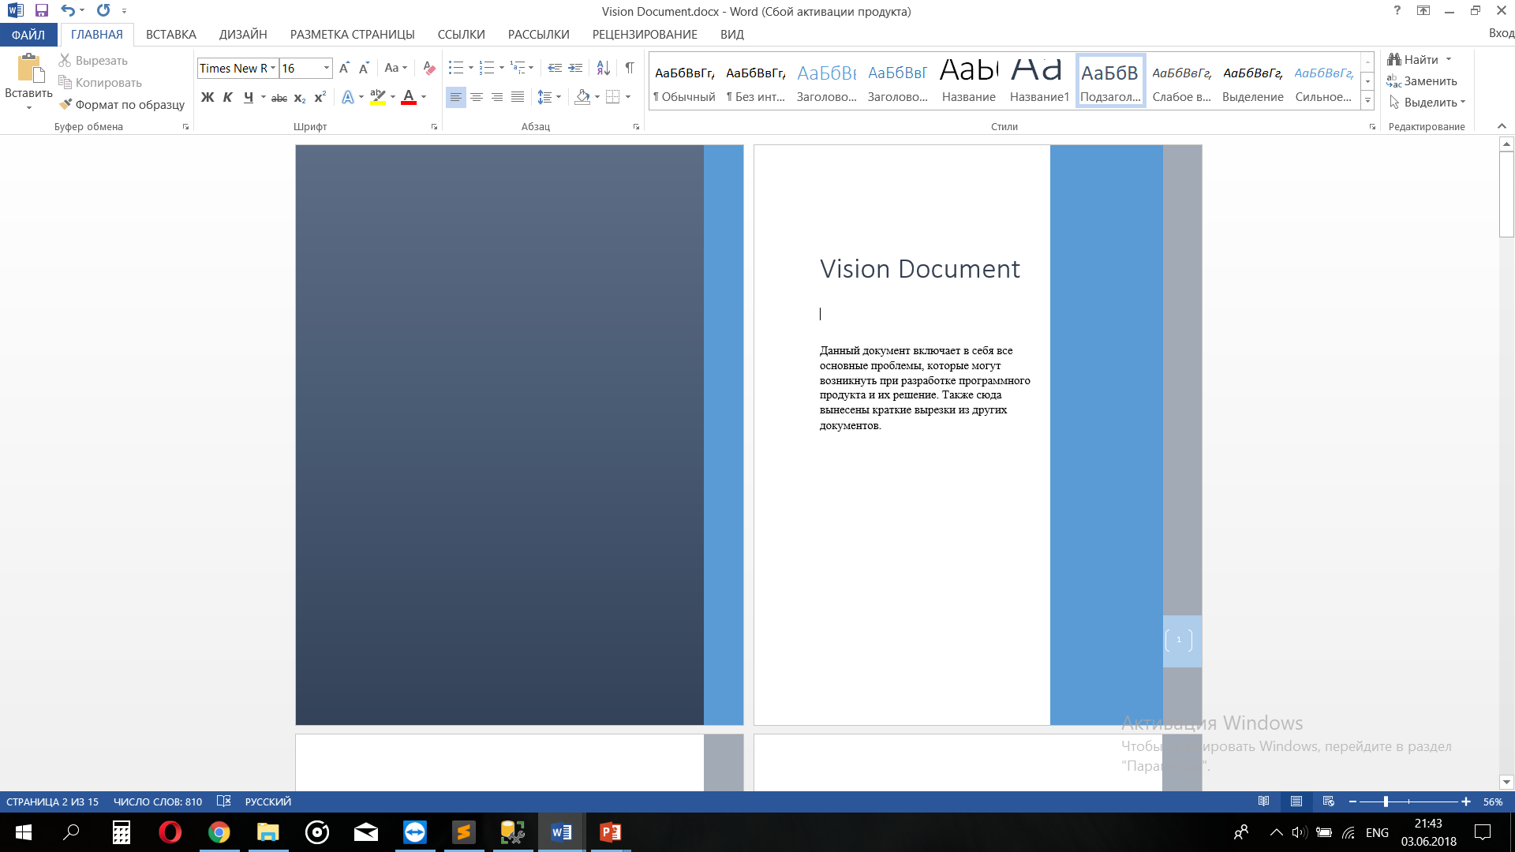
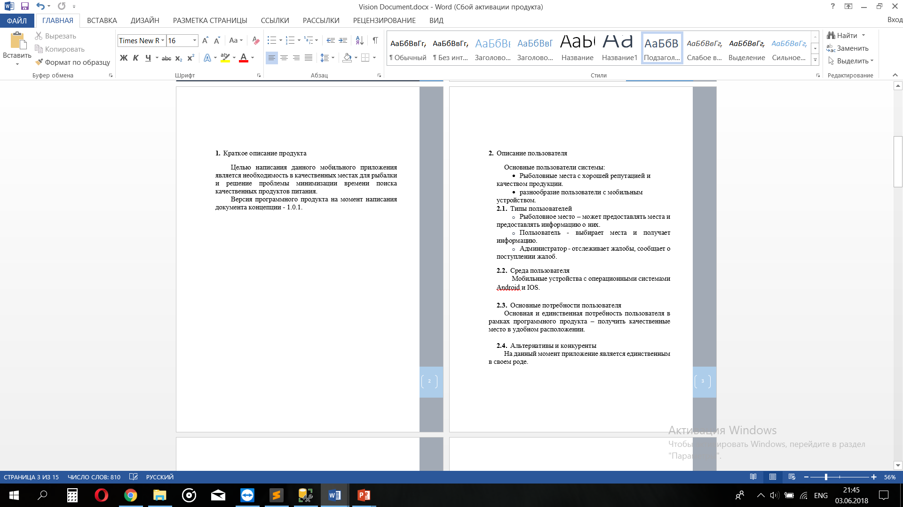
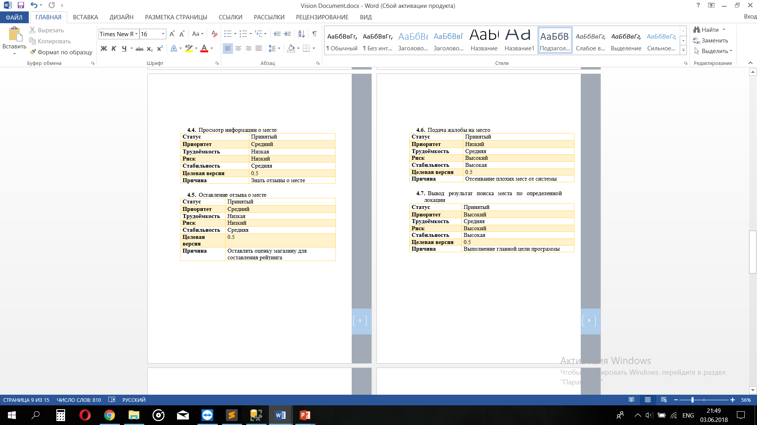
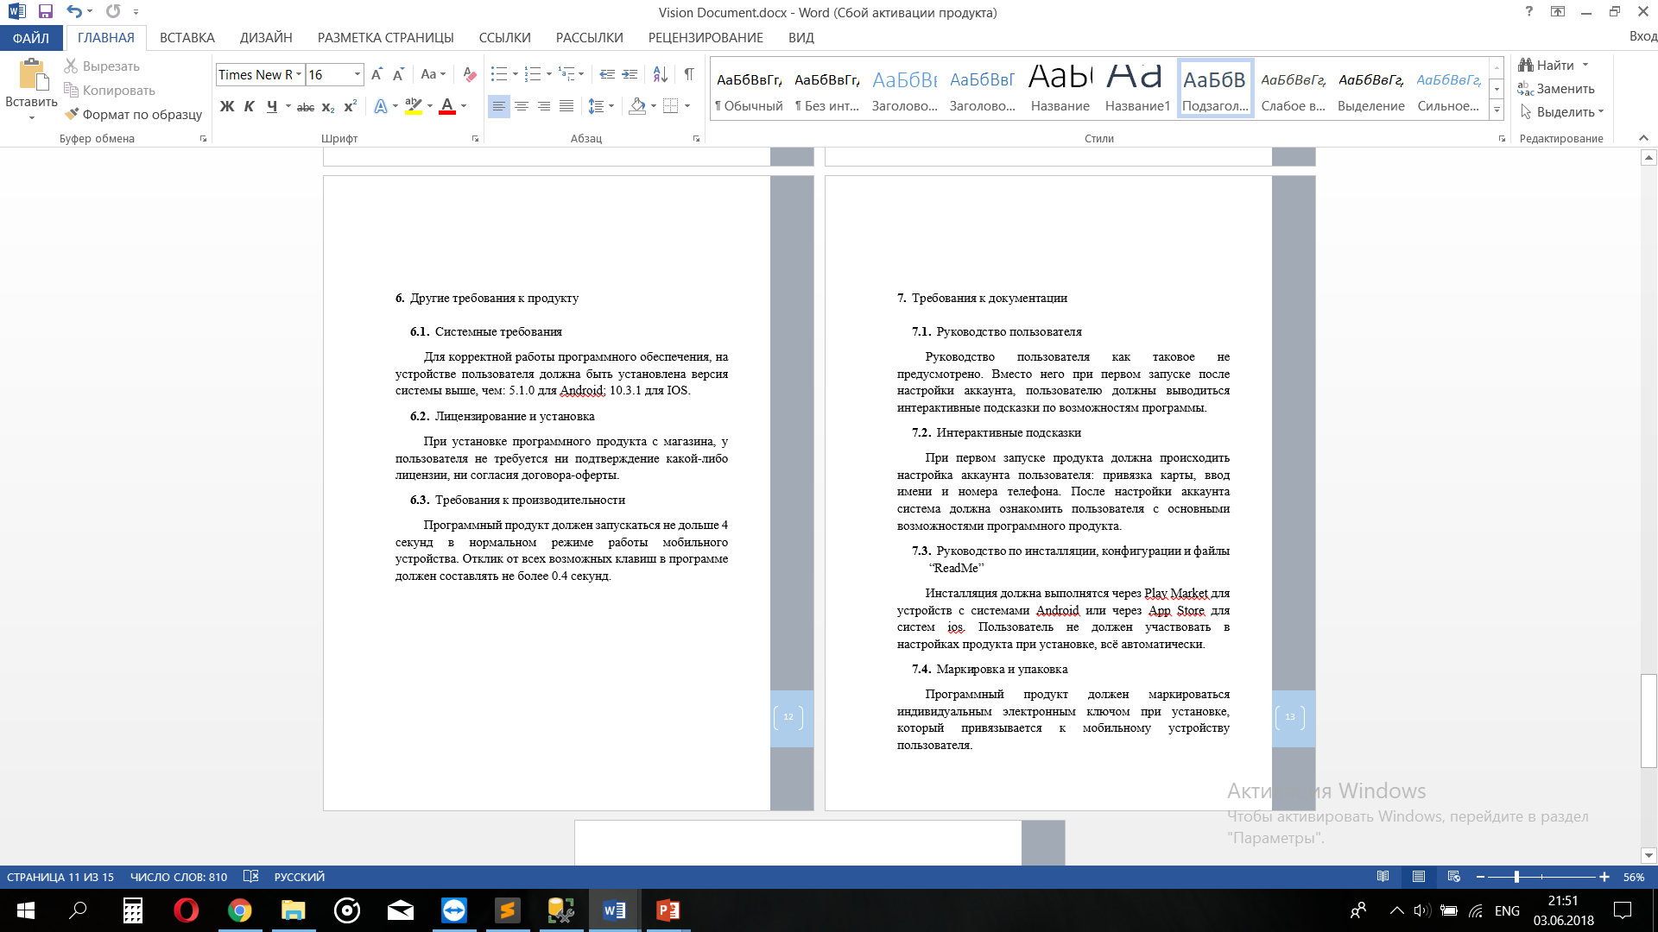
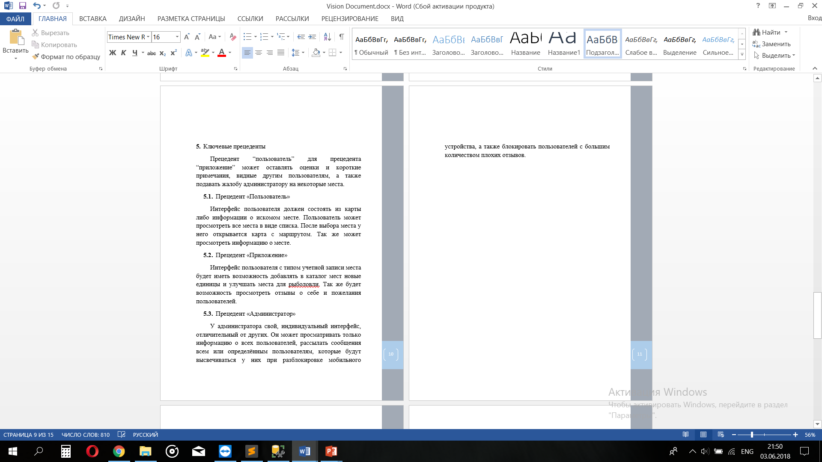
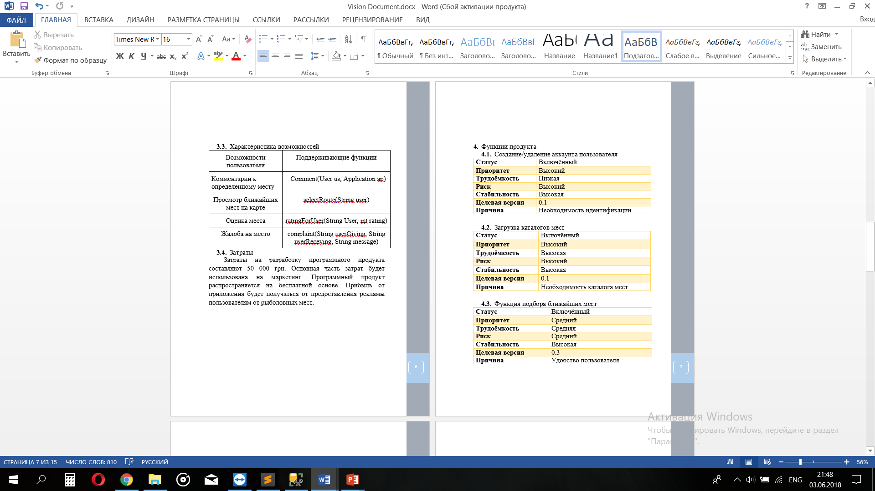
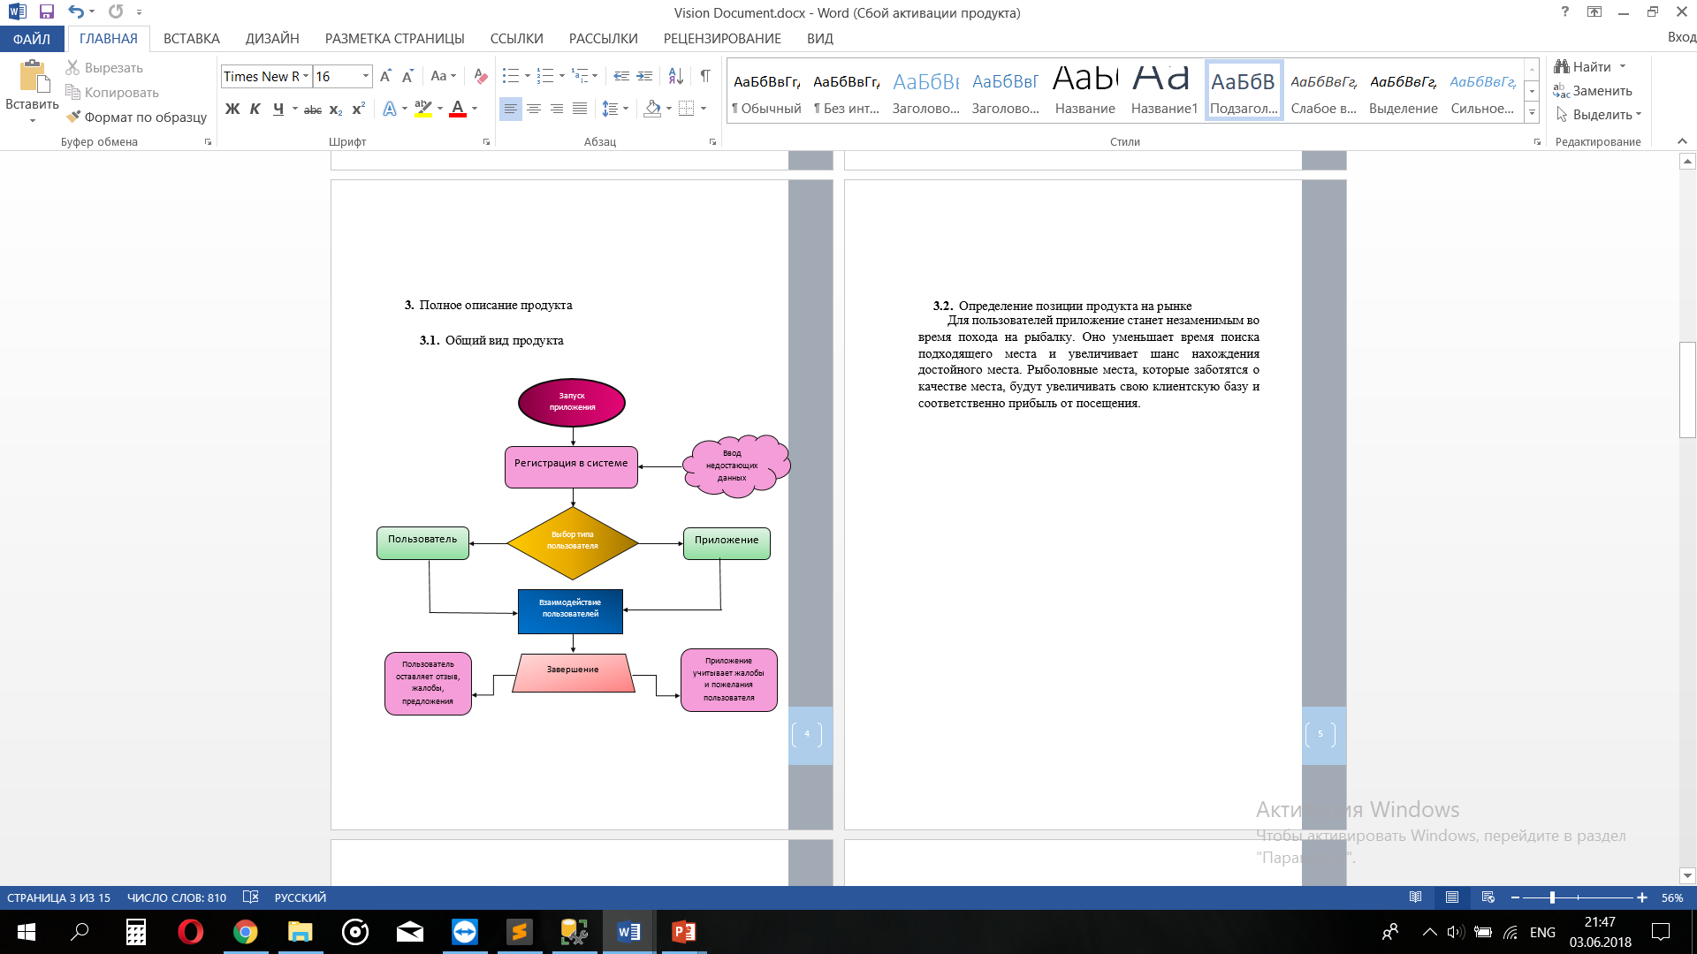
Vision Document

Slide 10
Document Delta Vision
This document includes changes in comparison with the previous version of both the concept document and the software product itself.
It was added features such as the ability to comment on the location, a map with the location of stores, adding a rating for the store. • The version of the software product at the time of writing the concept document is 1.1.0.

Slide 11
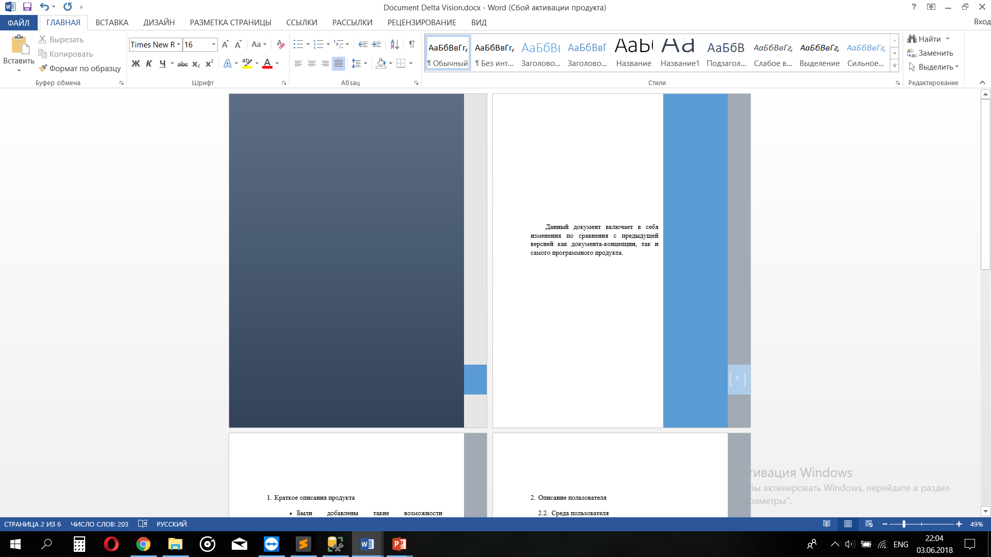
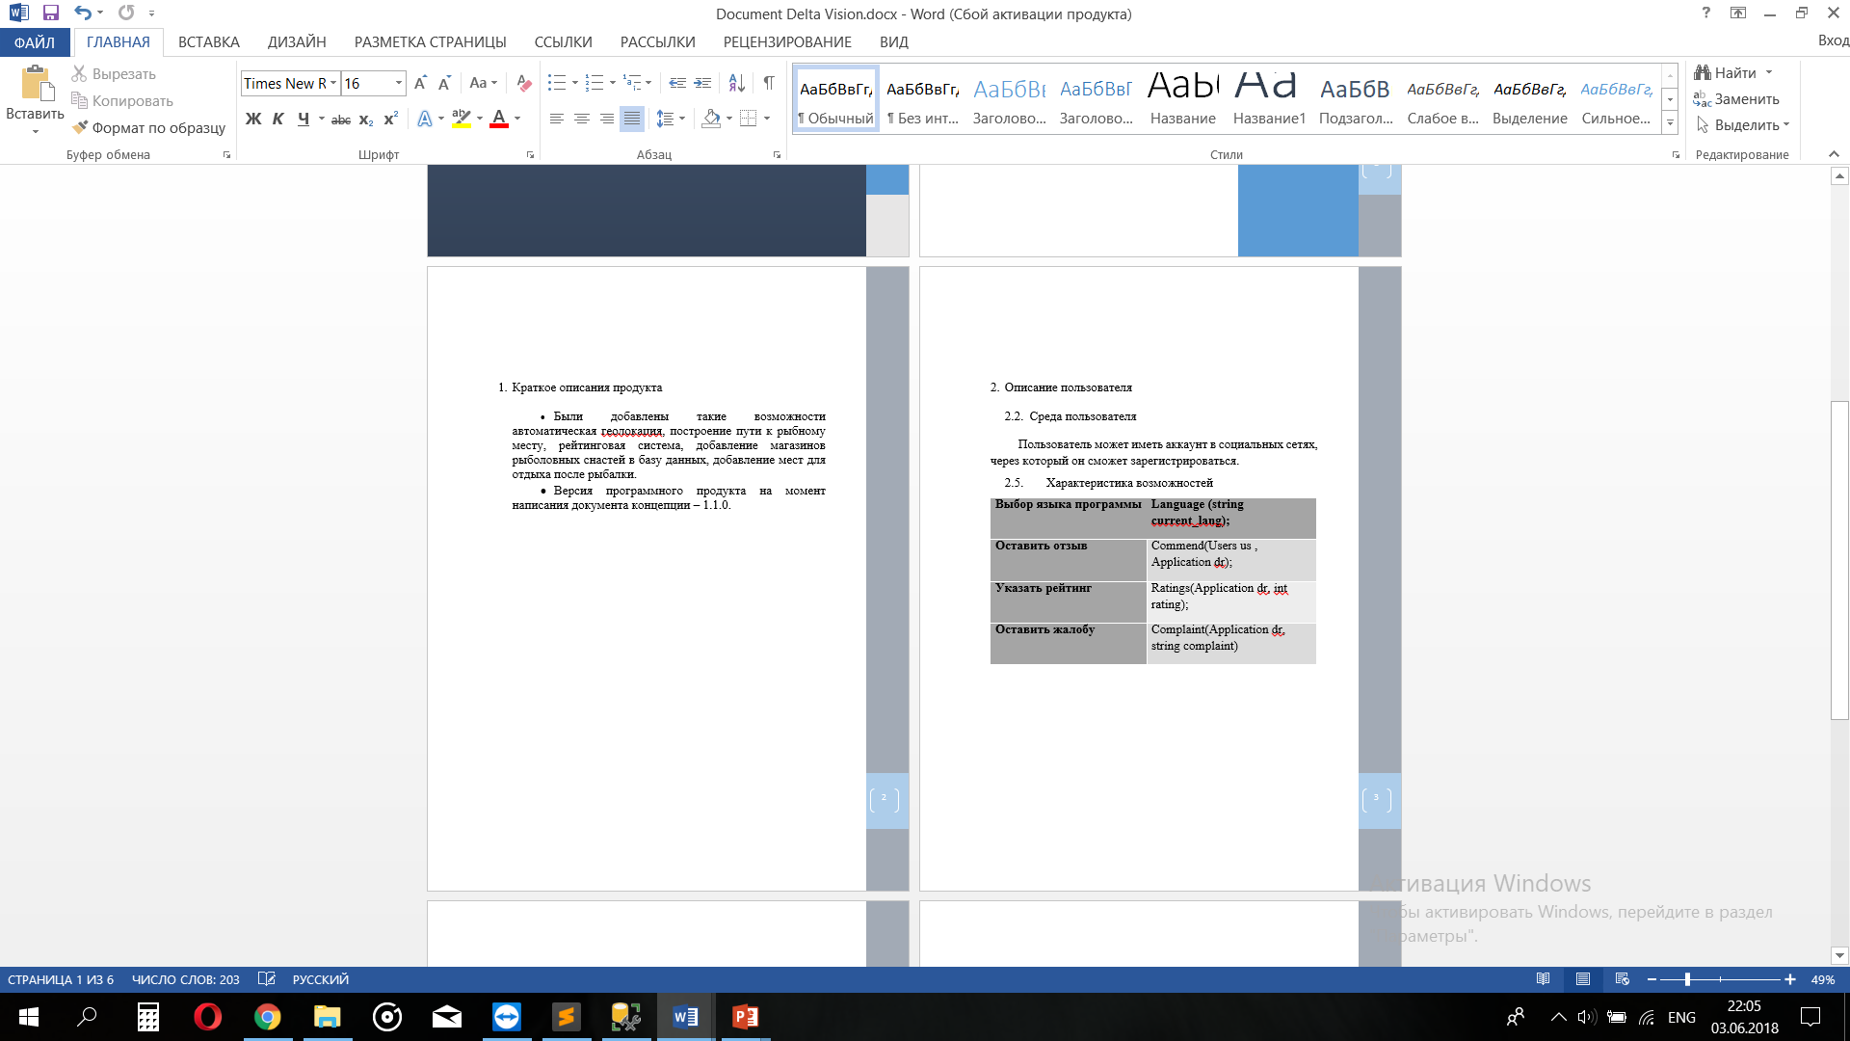
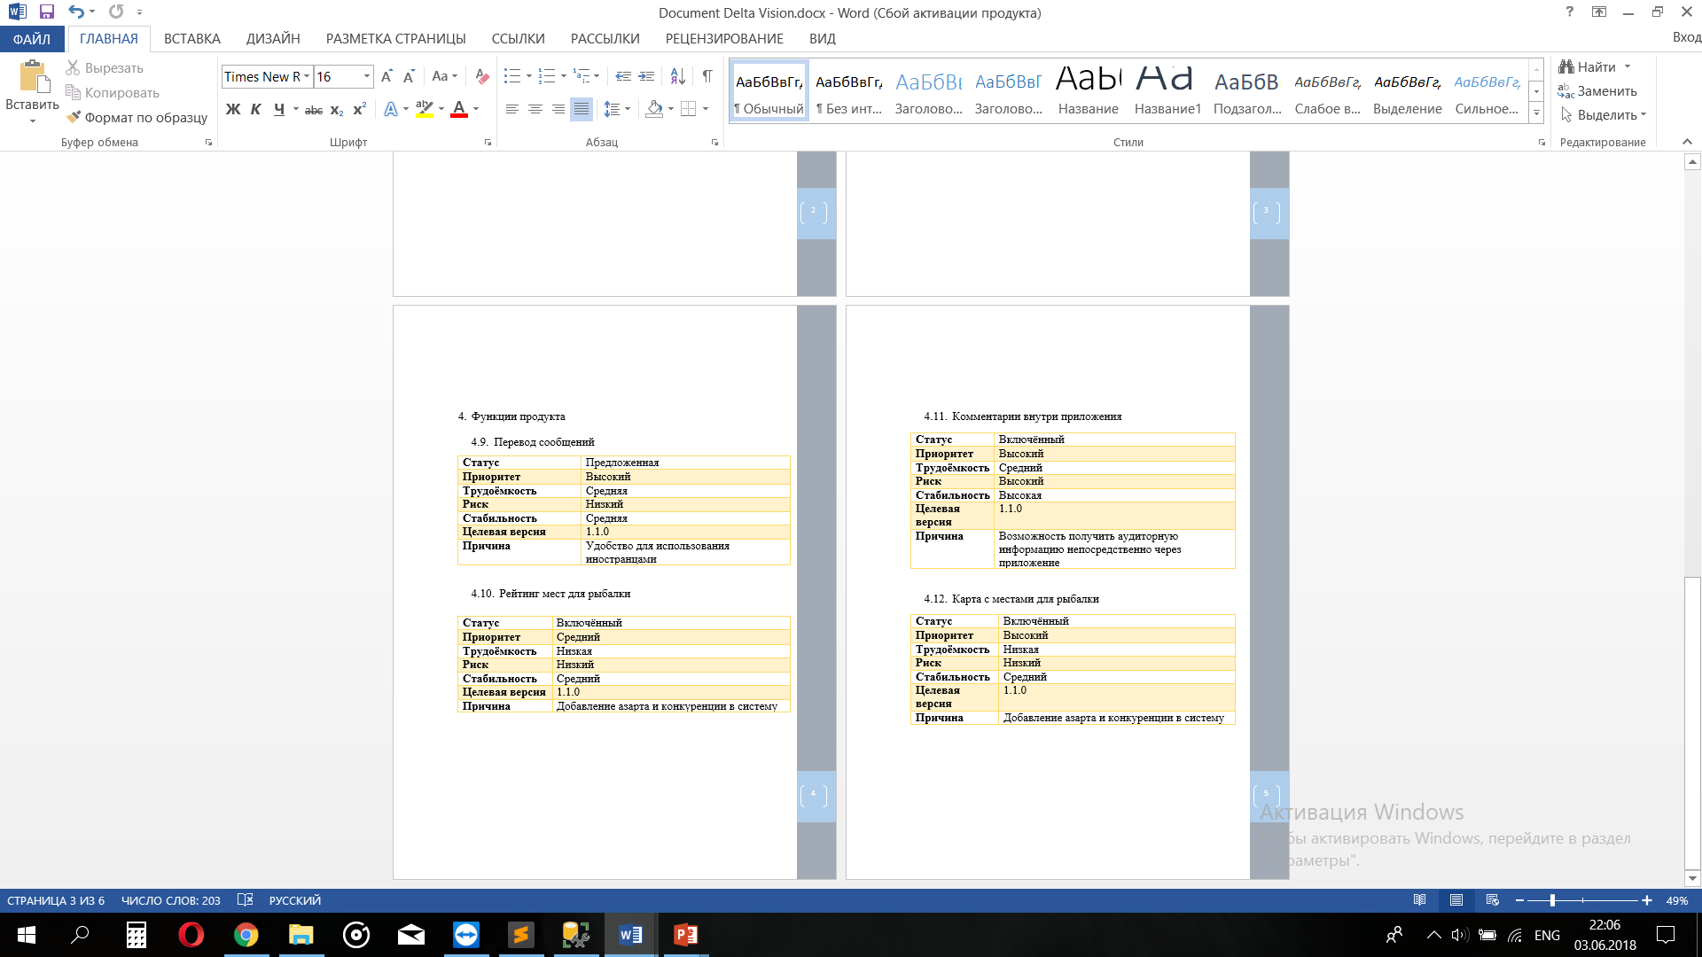
Document Delta Vision

Slide 12
Model of precedent of system level
User
Maps
View the fishing places around buyer
Add a new location
Compare prices
Feedback
Write review
Write commend
Complain
Application
Maps
Add address for fishing places in map
Add a network of fishing tackle stores
Feedback
To connect with users and tell about new good places
Administrator
To consider complaints
Deleting stores with poor rating from catalog

Slide 13


Specification of requirements for the subsystem "Map"
User
Application
Adds to the list of their places during the registration
The map shows the places, which were added by a type of the user “Application" to the card during registering with the service. The user selects the appropriate option from the options offered to him and the application pushes the user the shortest path to the destination.
Chooses the option he needs
The catalog of placed
Map
Adds on the map the address of the fishing places during the registration
Selects the appropriate place on the map
A type of the user “User" selects the places with the help of the search line. The application after the product selection opens the map with a visible radius of 3 kilometers for easy viewing and reading the map.
Route

Slide 14

Specification of requirements for the subsystem “Feedback"
Full
Information about the user
Partial
Reviews
User
Application
Leave a review about the application
Considers
customer reviews
A type of user “Application" only has access to general information. You can leave a response for the one of the fishing places.
Users who registered in the system could write to each other via chat. Also there is an opportunity for the type of user “User" to view the complete information about the type of user “Application".
Complaints
Administrator blocks fish places with very poor reputation
Administrator

Slide 15



4. Scope Management

Slide 16
№ | Function | Priority | Labor intensity | Risk
Basic level
4 | Displaying the most expensive / cheap place in the base of fish places | Critical | Average | Low
6 | Determination of the current location | Critical | Average | Low
9 | Route to the place | Critical | High | Low
7 | Calculating the cost of visiting a place | Critical | Average | Low

Slide 17
№ | Function | Priority | Labor intensity | Risk
Basic level
11 | Preservation of photo barcode locations in the database | High | Low | Low
5 | Multilanguage | High | Low | Low
1 | Ability to evaluate fish places | High | Average | Low

Slide 18
№ | Function | Priority | Labor intensity | Risk
Basic level
2 | Registration via social network | Average | Low | Low
12 | Saving data after an update | Average | Low | Average

Slide 19
№ | Function | Priority | Labor intensity | Risk
Additional level
3 | Selecting the range of the program | Average | Average | Low
10 | Automatic Notifications | Low | Low | Low

Slide 20
Input | Explanation | Output
User location | Required to find spots near the user | Map with surrounding spots
Current location | Required to track the position while en route to the spot | Route to spot
Spot visitation data | To have relevant data | Spot reviews
Spot registration | Administrator can add a new spot | New spot on the map

Slide 21
Слайды Вовы

Slide 22


Slide 23
чвсампиртоьлдб

Slide 24

Thanks For Your Attention

